Slide 1
What do they do here?

Slide 2
Learning intention
I will understand the role of local services and how the jobs within them can contribute to my local community
Success criteria
I can identify different jobs in my community and what they involve
I can understand the importance of these jobs in my community

Slide 3
Who might help you in the future?

Slide 4
What jobs can you think of for each of these categories
School
Sport and leisure
Community centre

Slide 5
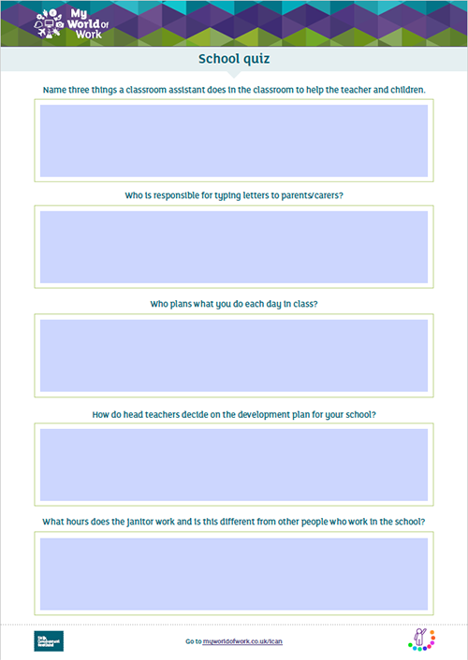
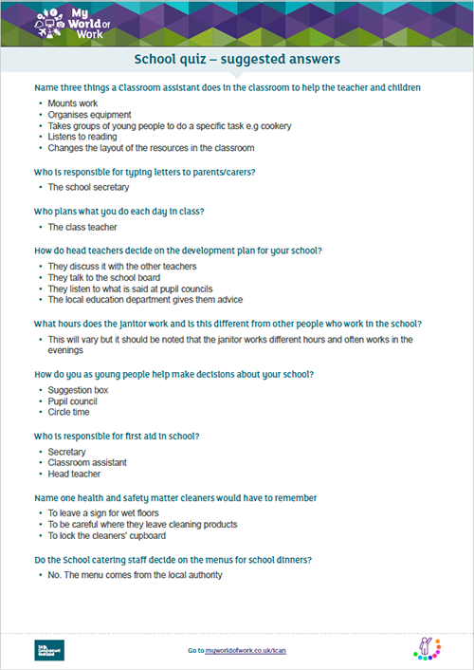
Complete the quiz
Use online resources and face to face interviews to help you
Did anything surprise you?

Slide 6
Go to myworldofwork.co.uk/primary and use your Profile to record what skills you have used taking part in this activity

