Slide 1
Visits

Slide 2
Learning intention
I will be able to identify the main post school routes including employment, Modern Apprenticeships, college and university
Success criteria
I can describe the different routes into the world of work
I can gather information through asking appropriate questions

Slide 3
In pairs, discuss what you can do when you leave school
College
Get a job
Modern Apprenticeship
University

Slide 4
Discuss dos and don'ts when outside school
What health and safety requirements do you need to be aware of?

Slide 5
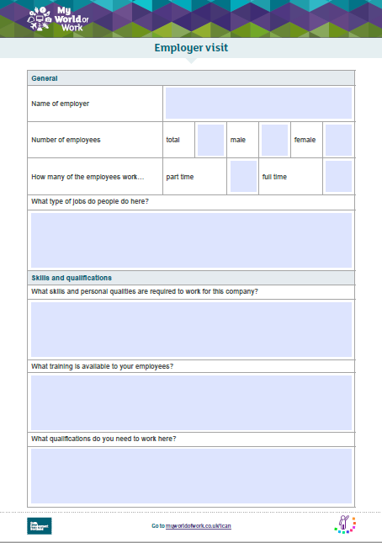
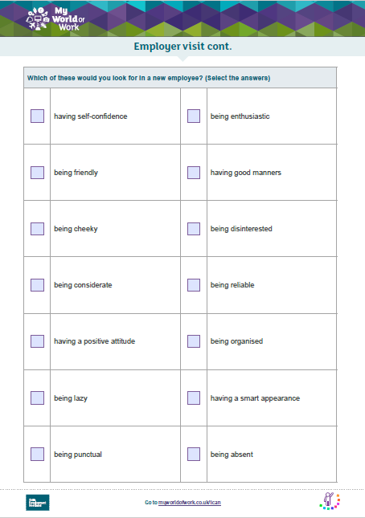
Look at the questionnaire – are there any questions you want to add?
Complete the questionnaires
Did anything surprise you?

Slide 6
Go to myworldofwork.co.uk/primary and use your Profile to record what skills you have used taking part in this lesson

