Slide 1
Stand up job game

Slide 2
Learning intention
I will be able to describe the skills and qualities required for different jobs and understand that these are more relevant than gender
Success criteria
I can describe how skills and qualities link to different jobs
I can explain why your gender should not influence your career choice

Slide 3
Stand up job game rules
Stand up and remain standing while you hear a group of statements relating to a particular job
If a statement does not apply to you, sit down
Everyone who remains standing after all of the statements have been read have some of the skills and qualities required to do that job

Slide 4
Do you get on well with people?
Are you a caring person?
Are you observant?
Are you interested in science?
Do you not mind the sight of blood?

Slide 5
Those still standing have some of the skills and qualities required for Nursing
Notes:
Nursing
Nurses care for people who are sick, injured or disabled and support them and their families when they are worried and upset.
They work with doctors to help care for their patients and make sure they feel well looked after.
Nurses can work in a hospital or in the community at a GP's surgery, health centre, clinic or school.
Nurses are expected to work evenings and weekends.
Useful subjects if you are interested in a career in nursing include English, Maths, Science and Care.

Slide 6
Are you good at using your hands?
Do you enjoy talking and listening to people?
Are you interested in fashion?
Are you interested in science?
Do you like standing for a long time?

Slide 7
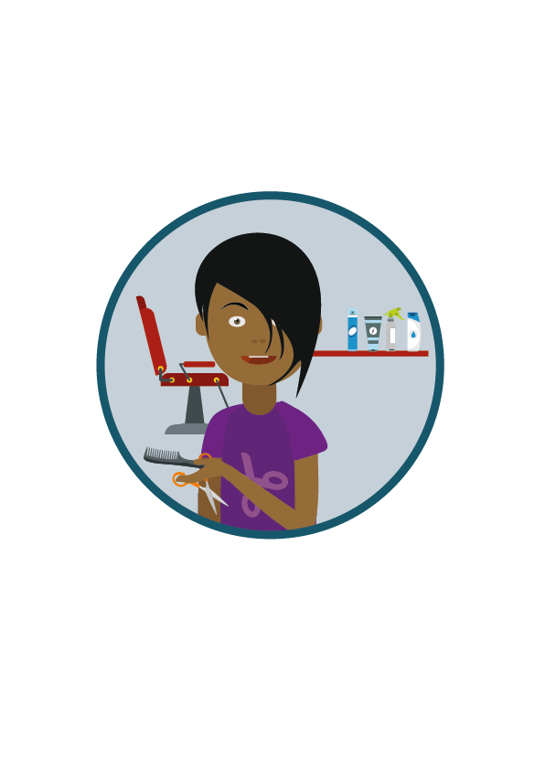
Those still standing have some of the skills and qualities required for Hairdressing
Notes:
Hairdressing
Hairdressers cut, colour and shape clients' hair to create the look they want.
They also need to make sure the salon is clean and tidy, make appointments and handle payments.
Hairdressers mostly work in a salon but they can also visit customers in their own homes.
They might be expected to work at evenings and weekends and would have to stand for long periods of time.
Useful subjects if you are interested in a career in hairdressing include English, Maths, Science and Care.

Slide 8
Are you good at researching things and writing reports?
Do you like watching the news?
Are you inquisitive?
Are you honest?
Can you work independently?

Slide 9
Those still standing have some of the skills and qualities required for Journalism
Notes:
Journalism
Journalists investigate and research any event of interest to the public. They get the facts and speak to the people involved.
Newspaper journalists write the story quickly and accurately to be published.
Broadcast journalists present the stories on television, radio or the internet.
Journalists can work in an office, a TV studio or they may even work from home if they are employed on a freelance basis. They also spend time out and about covering stories.
They can work long hours and may need to work evening and weekends to meet deadlines or cover breaking news stories.
Useful subjects if you are interested in a career in journalism include English, Maths, ICT and Social subjects such as Modern Studies, Media and Politics.

Slide 10
Do you have good information and computing technology (ICT) skills?
Are you creative?
Are you confident at explaining your ideas to other people?
Are you willing to consider jobs beyond your local area?
Do you work well in a team?

Slide 11
Those still standing have some of the skills and qualities required for Computer games design
Notes:
Computer games design
Computer games designers create ideas, characters and stories for games that might be played by millions of people.
They help to produce games for PCs, games consoles, the internet and mobile phones. They can develop new games or update existing titles.
Working hours in the computer games industry can vary. In many jobs computer games designers would work standard office hours, but with some additional hours, such as evenings and weekends to meet deadlines.
Computer games designers normally work in an office, or studio and spend most of their time sitting at a computer.
Useful subjects if you are interested in a career in computer games design include English, Maths, Art and Design, Computing and Physics.

Slide 12
Do you have a good memory?
Are you artistic and creative
Are you fit and strong?
Are you good at coping with change?
Do you like working with people?
Are you good at expressing yourself?

Slide 13
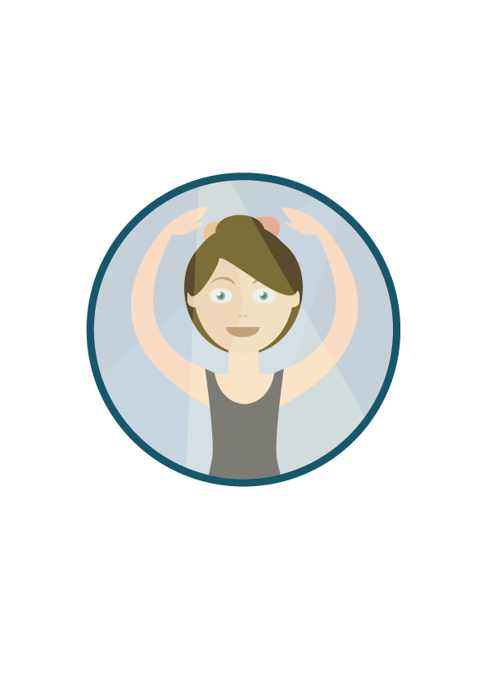
Those still standing have some of the skills and qualities required for Ballet dancing
Notes:
Ballet dancing
Ballet dancers use physical movement to tell stories and express emotions through music. They dance for live audiences or in recorded performances for television, film or music videos.
Ballet dancers use their talent, rhythm and timing combined with years of training to give the best performance to entertain the audience.
Performing would only be a small part of their work. Ballet dancers need to rehearse, and attend dance classes to keep fit and maintain their skills.
Ballet dancers might perform in venues including theatres, film or TV studios, hotels, halls and cruise ships. The work is physically very demanding, and they need to practise and keep fit even when not performing.
Hours can be long and irregular, with rehearsals and classes during the day and performances in the evening.
Useful subjects if you are interested in a career as a dancer include English, Maths, PE, Dance and Drama.

Slide 14
Are you good at working with your hands?
Are you able to work at heights?
Are you reliable and honest?
Do you have determination to see things through?
Do you like water?
Are you able to work in small confined spaces?

Slide 15
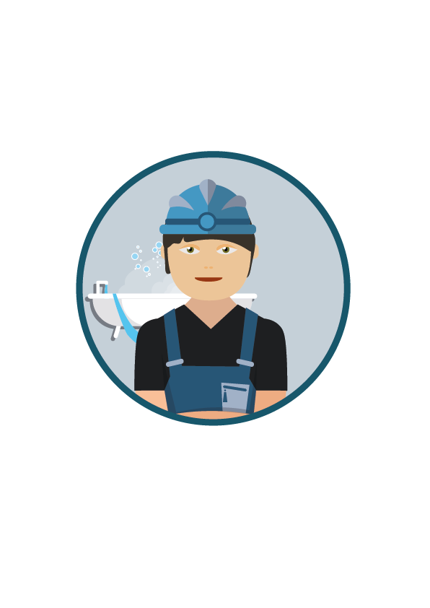
Those still standing have some of the skills and qualities required for Plumbing
Notes:
Plumbing
Plumbers fit and repair water and heating systems and appliances in homes and businesses. People who are having problems with their water supply or heating would rely on plumbers to get these systems up and running again as soon as possible.
Plumbers need to be good at following technical plans. They also need to have a good understanding of safety rules.
Plumbers work indoors, sometimes in cramped spaces, and outdoors in all weather conditions, sometimes at height.
Plumbers work around 40 hours a week, with the possibility of overtime. Some employers offer a 24-hour call-out service, which would involve working unsocial hours (like evenings, weekends and public holidays).
Useful subjects if you’re interested in a career in Plumbing include English, Maths, Technology.

Slide 16
Go to myworldofwork.co.uk/primary and use your Profile to record what skills you have used taking part in this lesson

