Slide 1
Skills Development Scotland
is your career service, and
My World of Work is your career website
They’re the people who will help you work out what you want to do when you leave school.

Slide 2
Life at… Where am I going?
Life at… Where am I going?

Slide 3
What are we going to cover today?
what are the different pathways I can choose when I leave school?
how do I qualify for different jobs?
learn more about college, university and apprenticeships and the jobs they can lead to.

Slide 4
Life at… Where am I going?
I am in the 1st year of my Electronics and Electrical Engineering degree. I have lectures at 2pm on Monday, Tuesday and Thursday. There are 300 of us in the class! Which room do you think my lectures take place in?

Slide 5
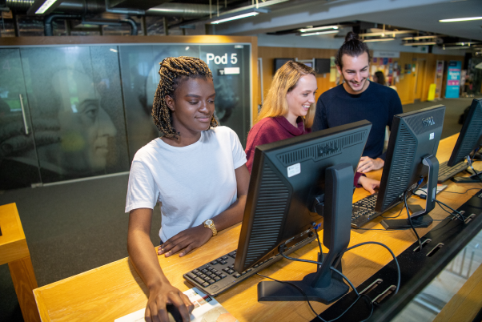
Life at… Where am I going?
A

Slide 6
Life at… Where am I going?
B

Slide 7
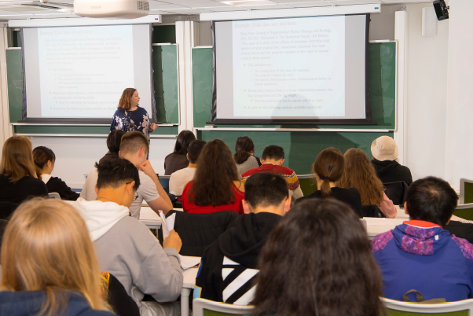
Life at… Where am I going?
C

Slide 8
Life at… Where am I going?
I am in the 1st year of my Electronics and Electrical Engineering degree. I have lectures at 2pm on Monday, Tuesday and Thursday. There are 300 of us in the class! Which room do you think my lectures take place in?
C

Slide 9
Life at… Where am I going?
I am in the 1st year of my
HNC in Social Work. At college I have tutorials I need to go to, as well as lectures. My lectures are really big but for tutorial we spilt up into small groups of 12-18. Where do you think I go for my tutorial?

Slide 10
Life at… Where am I going?
A

Slide 11
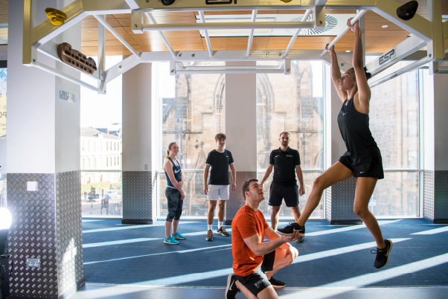
Life at… Where am I going?
B

Slide 12
Life at… Where am I going?
C

Slide 13
Life at… Where am I going?
I am in the 1st year of my HNC in Social Work. At college I have tutorials I need to go to, as well as lectures. My lectures are really big but for tutorial we spilt up into small groups of 12-18. Where do you think I go for my tutorial?
A

Slide 14
Life at… Where am I going?
I am doing a Graduate Apprenticeship in Engineering. Alongside working, I go to university as part of my apprenticeship. At work we tend to all have lunch at 12:30. However, I do not have a fixed lunchtime at university but always make the time to sit down and have something to eat between my classes and lectures. Where do you think I eat my lunch when I am at university?

Slide 15
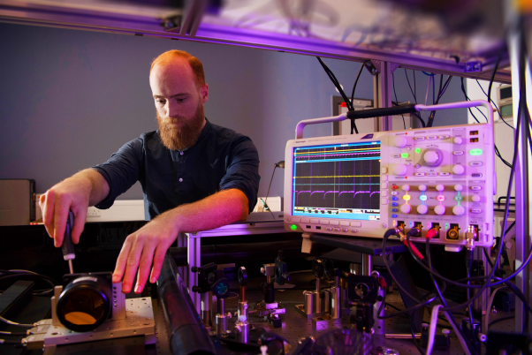
Life at… Where am I going?
A

Slide 16
Life at… Where am I going?
B

Slide 17
Life at… Where am I going?
C

Slide 18
Life at… Where am I going?
I am doing a Graduate
Apprenticeship in Engineering. Alongside working, I go to university as part of my apprenticeship. At work we tend to all have lunch at 12:30. However, I do not have a fixed lunchtime at university but always make the time to sit down and have something to eat between my classes and lectures. Where do you think I eat my lunch when I am at university?
B

Slide 19
Life at… Where am I going?
I am finishing up my Design course at college. For my course I have to do essays as well as submit coursework. I do a lot of my work in the library. It is open from 7am to 3am! It has loads of study spaces, computers and also all the books I need for my course. Which room do you think is the library?

Slide 20
Life at… Where am I going?
A

Slide 21
Life at… Where am I going?
B

Slide 22
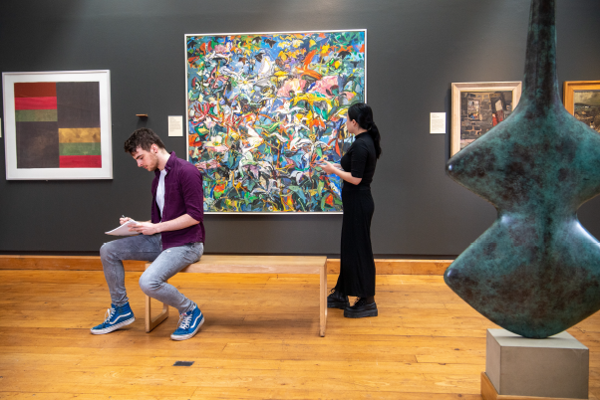
Life at… Where am I going?
C

Slide 23
Life at… Where am I going?
I am in the 1st year of my HNC in Social Work. At college I have tutorials I need to go to, as well as lectures. My lectures are really big but for tutorial we spilt up into small groups of 12-18. Where do you think I go for my tutorial?
A

Slide 24
Life at… Where am I going?
I am doing a Modern Apprenticeship in Dental Nursing. As part of my apprenticeship I have been doing some lab sessions at college. What do you think my lab looks like?

Slide 25
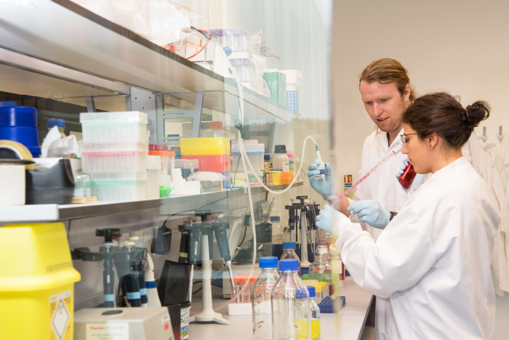
Life at… Where am I going?
A

Slide 26
Life at… Where am I going?
B

Slide 27
Life at… Where am I going?
C

Slide 28
Life at… Where am I going?
I am doing a Modern Apprenticeship in Dental Nursing. As part of my apprenticeship I have been doing some lab sessions at college. What do you think my lab looks like?
A

Slide 29
Life at… Where am I going?
I am studying Computing Science. I love my course but I also love staying active. When I started university I joined the women’s basketball team and use the gym between lectures and seminars. I met my best friend by taking part in uni sports! What do you think the university gym looks like?

Slide 30
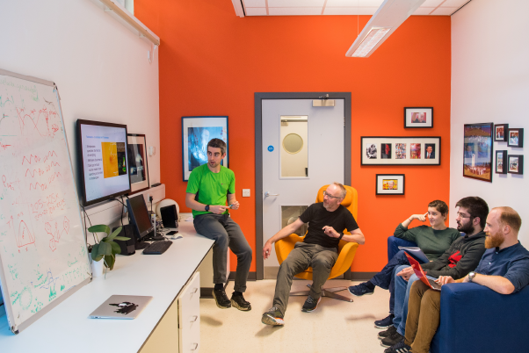
Life at… Where am I going?
A

Slide 31
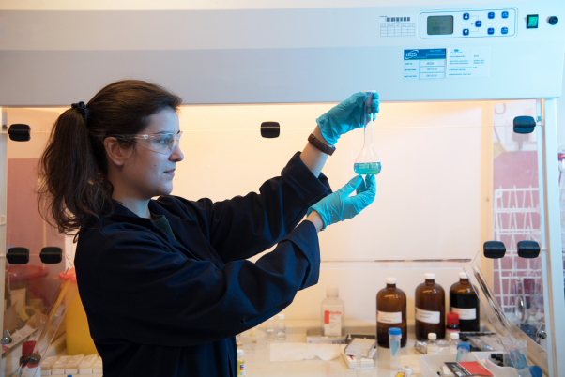
Life at… Where am I going?
B

Slide 32
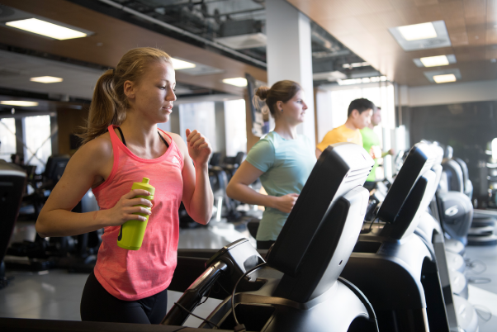
Life at… Where am I going?
C

Slide 33
Life at… Where am I going?
I am studying Computing Science. I love my course but I also love staying active. When I started university I joined the women’s basketball team and use the gym between lectures and seminars. I met my best friend by taking part in uni sports! What do you think the university gym looks like?
C

Slide 34
Life at… Where am I going?
I am finishing my Graduate Apprenticeship in Early Learning and Childcare. I decided I wanted to work with children in S4. The university part of my course has been an amazing experience but I cannot wait to graduate in July! It really put the work I was doing in my nursery into context. My parents and sister are all coming to see me graduate and get my degree. What do you think my graduation will look like?

Slide 35
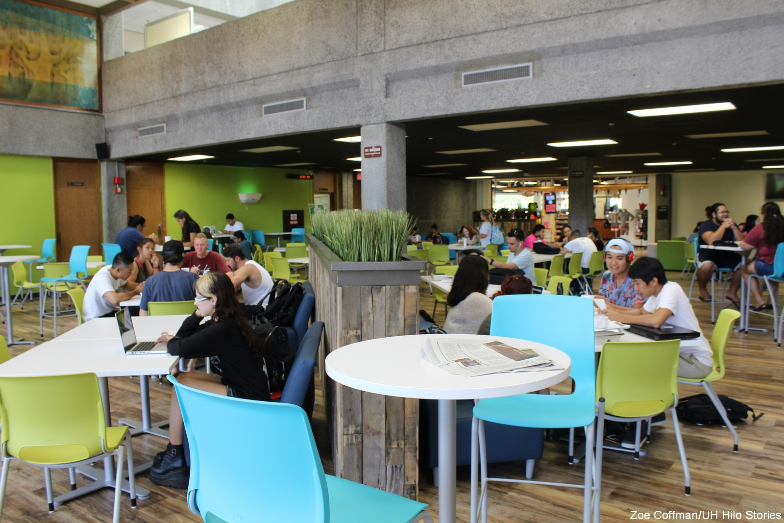
Life at… Where am I going?
A

Slide 36
Life at… Where am I going?
B

Slide 37
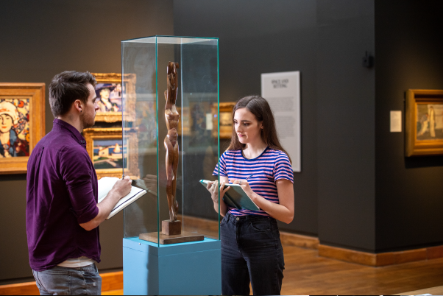
Life at… Where am I going?
C

Slide 38
Life at… Where am I going?
I am finishing my Graduate Apprenticeship in Early Learning and Childcare. I decided I wanted to work with children in S4. The university part of my course has been an amazing experience but I cannot wait to graduate in July! It really put the work I was doing in my nursery into context. My parents and sister are all coming to see me graduate and get my degree. What do you think my graduation will look like?
B

