Slide 1
Skills and strengths
Creating a personal statement for a CV
Senior Phase
Notes:
Creating a personal statement for a CV activity
The purpose of this activity is to write a personal statement for a CV.
Introduce the session:
In this activity you will learn about what a CV is and why a good personal statement is important in a CV. You will learn about what you should include in a personal statement and write your own, which you can enter into the CV builder in My World of Work to start creating your own CV.

Slide 2
Skills & strengths
Learning intention
I will learn about CVs
Success criteria
I can use language in my CV which promotes who I am
I can describe why a good personal statement is important in a CV
I can complete a personal statement using the CV builder
Notes:
Learning intention and success criteria
Go over the learning intention and success criteria with the class.
These can be adapted to suit the needs of your pupils and can be used as the basis for discussion.
To edit the information on the slide click on the slide and edit the text box.

Slide 3
Skills & strengths
What is a CV and personal statement?
A CV is your opportunity to grab an employer’s attention and get an interview
Many CVs start with a personal statement
This is a marketing technique to capture the employer’s interest straight away
It shows the strengths, skills and personal qualities you have demonstrated through your life and learning experiences
Notes:
What is a CV and personal statement?
Ask what CV (Curriculum Vitae) stands for and discuss what a CV is. Highlight that a CV is your opportunity to grab an employer's attention and get an interview. It tells the story of what you've done and what you can do.
It might be helpful to show an example CV. You can use the school leaver example at the link below on My World of Work.
https://www.myworldofwork.co.uk/getting-job/example-cvs-and-cover-letters-school-leaver
Check understanding of the personal statement section. Highlight that your personal statement introduces you to an employer, and shows a little of your personality.
For more information and for further discussion points refer to the tutorial on How to create a personal statement on My World of Work
https://www.myworldofwork.co.uk/getting-job/tutorial-crafting-personal-statement-cv

Slide 4
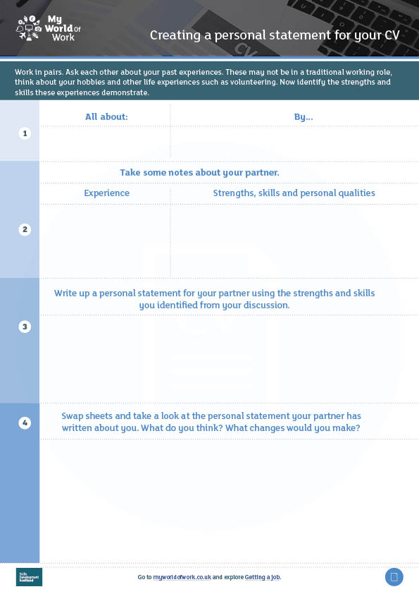
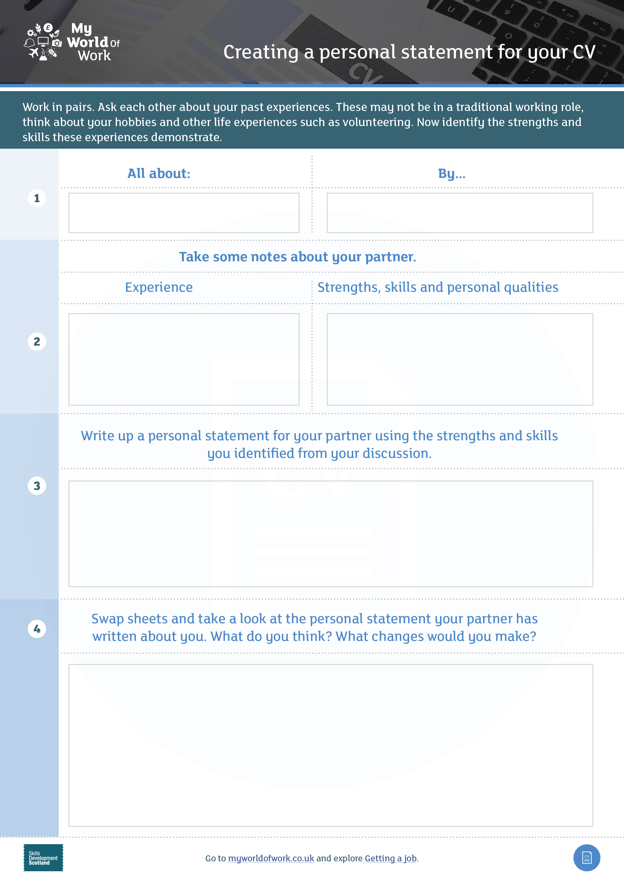
Skills & strengths
Activity
Think about your hobbies and other life experiences such as volunteering
Now identify the strengths and skills these experiences demonstrate
Discuss them with a partner
Jamie
Kirsten
Volunteers at after school club
Friendly
Reliable
Artistic
Notes:
Creating a personal statement
Working in pairs, groups or cooperatively, explain that they are going to help each other to start to write a personal statement as many people find this the most difficult part about creating a CV .
Ask pupils to discuss their experiences, strengths, skills and personal qualities.
Issue the worksheet for pupils to complete.
Activity continued on Slide 5.

Slide 5
Skills & strengths
Activity (cont.)
Take some notes about your partner’s experience
Now identify and take note of the strengths, skills and personal qualities these experiences demonstrate
Write up a personal statement for your partner using the strengths and skills you identified from your discussion
Swap sheets and take a look at the personal statement your partner has written about you
What do you think? What changes would you make?
Notes:
Creating a personal statement continued
Using the worksheet, each pair should write a statement for each other based on the information they shared.
Give pupils a maximum word limit on this as a personal statement for a CV or job application should be fairly concise and is normally between 50 -100 words.
Pupils should then exchange statements and discuss.
Ask young people to read and rewrite their statements in their own words.

Slide 6
Skills & strengths
Now log on to myworldofwork.co.uk to explore Getting a job
Notes:
Complete personal statement in My World of Work and Next steps
If there is suitable ICT with internet access pupils can now type up their statement directly into the Personal Statement section of the CV builder on My World of Work, which provides a template to help anyone create a CV.
Pupils should go to myworldofwork.co.uk and log in
Select the blue ‘Getting a job’ section and scroll down the page to the CVs and applications area and click here
In this area they should select ‘How to a write a CV’ and from here they will be able to access the CV builder by selecting ‘Make a CV’
Pupils will be presented with a list of sections they can complete to build their CV but at this stage just ask them to select ‘personal statement’ and enter their pre-drafted personal statement
Once this has been done they should press save and exit or they can go on and complete the other sections if time allows
Alternatively, pupils can complete the rest of their CV at another time in school or at home.

