Slide 1
My World of Work Registration
Notes:
My World of Work Registration activity
The purpose of this activity is to learn how to use and create a My World of Work account.
Introduce the session:
My World of Work is Scotland’s careers information and advice web service. My World of Work can help you to prepare for your future, whatever stage you’re at.
This activity will guide you through the different areas in My World of Work, explain how you can create your own account and show you how you can explore the tools and information for yourself.
Find out more information here about creating a My World of Work Account:
My World of Work Account factsheet - https://www.myworldofwork.co.uk/account-factsheet

Slide 2
Learning intention
I will learn how to use and create my own My World of Work account
Success criteria
I can create an account on My World of Work
I can successfully login and navigate my way around the website
Notes:
Learning intention and success criteria
Go over the learning intention and success criteria with the class.
These can be adapted to suit the needs of your pupils and can be used as the basis for discussion.
To edit the information on the slide click on the slide and edit the text box.

Slide 3
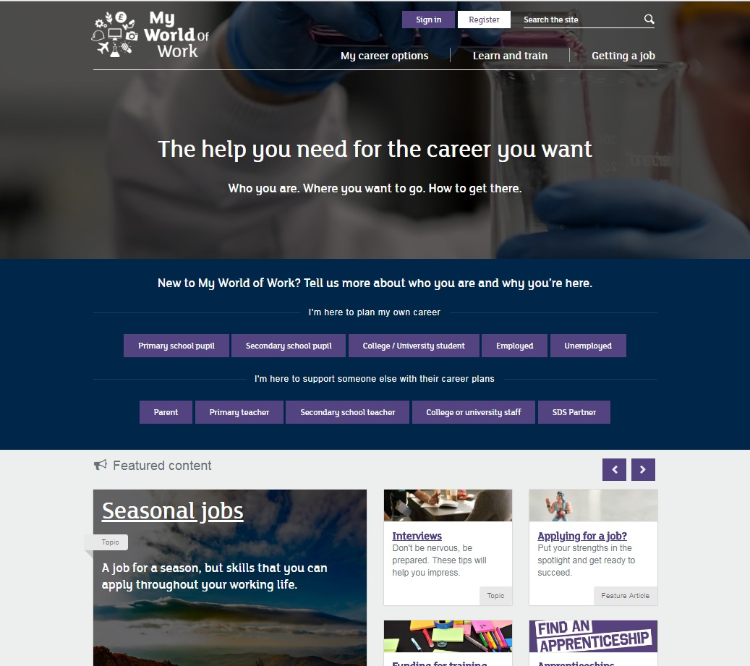
My World of Work is here to help you with up-to-date careers information, advice and tools
Notes:
Introduction to My World of Work
Explain that there are certain skills and knowledge that will help them prepare for the world of work. Ask pupils what they think they are.
You might find it useful to refer to the Career Education Standard and the illustrative ‘I can’ statements that have been designed to support the development of career management skills.
https://www.education.gov.scot/Documents/dyw2-career-education-standard-0915.pdf
Education Scotland suggests that ‘These statements can be used as a basis for dialogue with children and young people to agree what success could look like’.
Now introduce My World of Work and explain that it can help them develop career management skills and prepare for the world of work.
Give pupils an overview of the website -
There are three main sections in My World of Work
My career options
Learn and train
Get a job
My career options helps you find out more about yourself and explore your options. Explore your self and strengths via the interactive tools, get personalised job suggestions and explore how your school subjects relate to different jobs. It is a great place to start if you are taking the first step on your career journey or want to explore your ideas further.
Learn and train helps you explore learning opportunities e.g. college, university, training, volunteering (this section may be more suitable for Senior phase pupils).
Get a job helps you to find and apply for jobs e.g. search vacancies, create a CV and prepare for an interview (this section may be more suitable for Senior phase pupils).

Slide 4
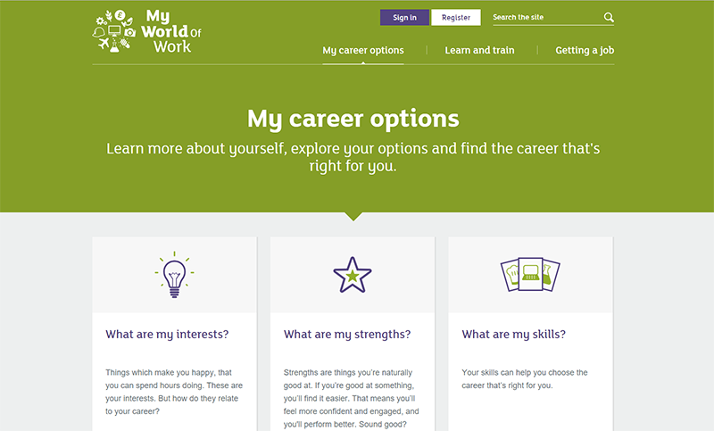
My career options
Explore your options, from school subjects right through your career. Find a job that suits you.
Notes:
My career options
Find out what career options your education, experience, skills and strengths can open up for you. Explore the job profiles, industries and Modern Apprenticeship opportunities that could suit your interests and ambition.
From the homepage, click on ‘My career options’ to get started.
This takes you to the My career options screen, where you can complete the different sections in ‘Personalise your account’ – About me, Strengths, Skills. As you begin to complete the sections you will get personalised career suggestions based on your likes and interests.
If you have an idea of things you like to do but don’t know the exact job you can select the ‘I have a rough idea’ tab to explore jobs related to your interests.
Or, if you already have a particular career in mind you can find out more about it using the ‘I have a career in mind’ tab.
Whatever tab suits you best, your search results will provide relevant job profiles, related industries and types of Modern Apprenticeships for you.
Job profiles show details of the role, entry requirements, related skills and working conditions. You can also find video clips and Real people stories which show the journey of people in similar roles, salary information and related careers.
Below the initial My career options screen, you can scroll down to find more information and videos on things to consider when exploring your career options.
One of these is ‘Choosing my subjects’ which includes a tool where you can enter up to six school subjects to explore the related jobs. You can use this tool to help decide what subjects to study at school.

Slide 5
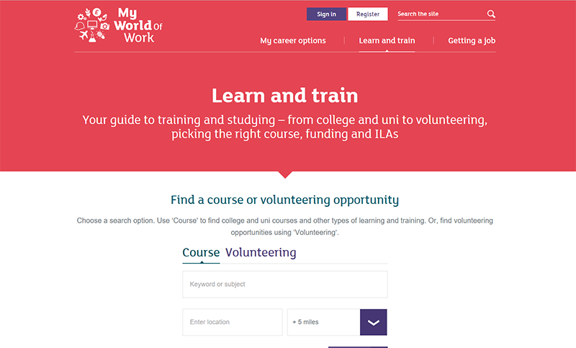
Learn and train
Search for courses and volunteering opportunities. Get advice on how to apply for courses, qualifications and funding.
Notes:
Learn and train
NB. This section may be more suitable for those in the Senior phase but can be used in the BGE by those who want to explore options for the future and are considering work experience.
If you are thinking about studying at college or university in the future you can search for courses and training to suit you and get advice on choosing and applying for courses and funding. You can also search for voluntary opportunities to help you gain work experience.
From the homepage, click on ‘Learn and train’.
This takes you straight to the course and volunteering search, which allows you to search for current courses and volunteering opportunities across Scotland. Type in a location and a search radius to narrow or expand the results.
Results can be filtered further by (for example) qualification level or attendance and they can be restricted to only courses in Scotland.
To look for volunteering opportunities, click on the ‘Volunteering’ tab.
From the results you can select a course (or volunteering opportunity) to get more information about the course, the provider and entry requirements.
Below the initial Learn and Train screen you can scroll down to find more information and videos on things such as advice on funding, applying for a course, different learning options and qualifications.

Slide 6
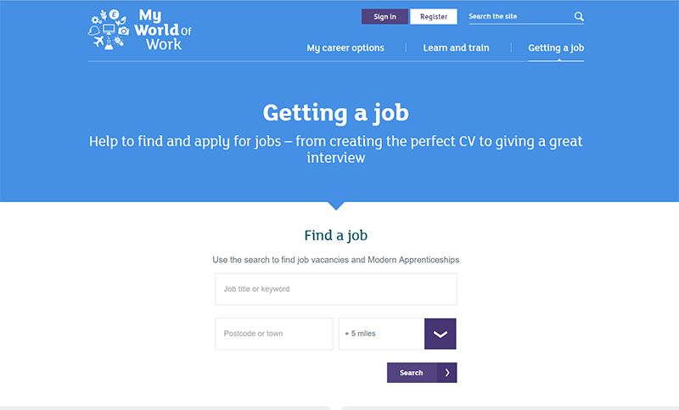
Getting a job
Search for job vacancies. Use the tips and tools to write CVs or application forms, and get ready for interviews.
Notes:
Getting a Job
NB. This section may be more suitable for those in the Senior phase but can be used in the BGE by those who want to explore options for the future and are considering work experience.
Here you can get help with every step of your job hunt, whether you’re looking for part-time work after School, a Saturday job, or your future career. You can get advice on how to search for jobs, through to information about work experience and Modern Apprenticeships so that you are prepared for the future.
When you find the right opportunity, you can use the resources to help you apply, create the perfect CV and prepare yourself for the interview.
From the homepage, click on ‘Getting a job’.
This takes you straight to the Find a job search, which allows you to search for current vacancies and Modern Apprenticeships across Scotland. You can type in a location and a search radius to narrow or expand the results; there are other options when the results appear e.g. Full-time, part-time etc available in the form of tick boxes.
Under the boxes, you will then see a list of available vacancies and Modern Apprenticeship opportunities.
From the vacancies displayed, click on the title to display details of the job, including; a description, contract type, hours and any salary information. The date the vacancy was posted and the closing date, will be shown, and a link provided to display more information and apply for the job.
Below the initial Getting a job screen you can scroll down to find more information and videos. These include advice on CVs and applications, and help preparing for that all-important interview.

Slide 7
Create a My World of Work account
Select ‘Register’ to get started with My World of Work
Email address and password
Enter a valid email address
Password must be at least eight characters in length and must contain one uppercase character and two numbers
Record your details!
Complete the registration form and save your account details somewhere safe
Notes:
Creating an account
Pupils should then select ‘Register’ on the homepage to start the registration process of their My World of Work account.
Check everyone has an email address and help them create one if necessary.
Discuss requirements to create a My World of Work account:
A valid email address
Password should be at least eight characters in length and contain at least one uppercase character and at least two numbers
Pupils will need to enter their home postcode when registering (where necessary, use Google maps to search for post code)
Complete and submit registration form.
Hand out registration worksheet.
Ask pupils to record their login details on the My World of Work registration worksheet.
Some pupils may also want to keep a personal reminder of their password somewhere safe. Suggested methods for recording details:
School student planner/diary
Personal folder on a shared network
On a mobile phone

Slide 8
About me
After registering select About me from the core tools message
Go to About me and complete the quiz
Select your favourite image from each page. Pick things you’d enjoy!
Once completed, you will get a report about the three personality types that you are most like
Notes:
About me
• Pupils should now see a reminder message indicating that they have not yet completed any of the core tools in My World of Work.
• Ask pupils to click on the link to the About me tool
• Pupils should now complete the quiz to gain an understanding of their core personality traits
• Pupils should select their favourite image from each page. They should pick things they’d enjoy and their answers will be used to build up a picture of who they are
• Once completed, they will get a report about the three personality types they are most like
• Pupils should then select ‘View your career suggestions’ to get suggestions of careers that might suit them based on their results

Slide 9
Explore My World of Work
Once you have completed About me you can explore your options, just select ‘View career suggestions’
Have a look at your career suggestions and research what they involve
Notes:
Explore My World of Work
Once they have selected ‘View career suggestions’, pupils will see a list of potential job profiles, industry overviews and Modern Apprenticeship types matched to their personality traits
• Pupils can browse their career suggestions and research what they involve

Slide 10
Notes:
Next steps
Pupils can complete the three tools within their account, at home or in class.
Tools
About Me – a short quiz in which you select images in response to questions, and which identifies your personality type
Strengths – a quiz to identify the things you’re naturally good at, and that you enjoy, helping to find careers that match you
Skills – identify the skills you have developed during school, study, work or volunteering and find the careers to match
You can compete as few or as many of the sections as you wish, but the more information that is entered, the more information on your career options is returned. At any point in time the sections may be switched off or on while reviewing your career suggestions, in order to get the best match for you.
To see the career suggestions provided by the tools, click on the button at the end of each section, or go to ‘My Career Options’ from the site homepage.
Consider completing the Strengths activity next that you will find in the partner resources area in My World of Work.

