Slide 1
Routes and pathways
Making decisions
BGE Third/Fourth
Notes:
Making decisions activity
The purpose of this activity is to help pupils understand the steps and influences involved in making considered career decisions.
Introduce the session:
In this activity you will learn about the steps involved in making a career decision by considering the types of decisions you already make in your life and how you make them. You will then consider how using a similar process can help you to make your own career decisions.

Slide 2
Routes and pathways
Learning intention
I will learn about the steps involved in making a career decision
Success criteria
I can reflect on the steps I have taken to make decisions in the past
I can discuss and make decisions about my own career
Notes:
Learning intention and success criteria
Go over the learning intention and success criteria with the class.
These can be adapted to suit the needs of your learners and can be used as the basis for discussion with pupils.
To edit the information on the slide click on the slide and edit the text box.

Slide 3
Routes and pathways
Introduction to decision making
Everyday we make decisions
Some decisions are small and easy to make and some bigger decisions need more time and thought
Decision making is a process of gathering information to help understand our choices
Notes:
Introduction to decision making
Discuss and define what is meant by decision making using the information on the slide.

Slide 4
Routes and pathways
In your groups, start to make a list of the following:
2020
Group A
What decisions did you make yesterday?
Group B
What decisions did you make last week?
Group C
What decisions did you make last month?
Group D
What decisions did you make last year?
Notes:
Introduction to decision making continued
Split the class up into groups of four
Ask each group to list all the decisions they can think of based on one of the timescales below.
Group 1: What decisions did you make yesterday?
Group 2: What decisions did you make last week?
Group 3: What decisions did you make last month?
Group 4: What decisions did you make in the last year?
Discuss each group’s answers with the class.

Slide 5
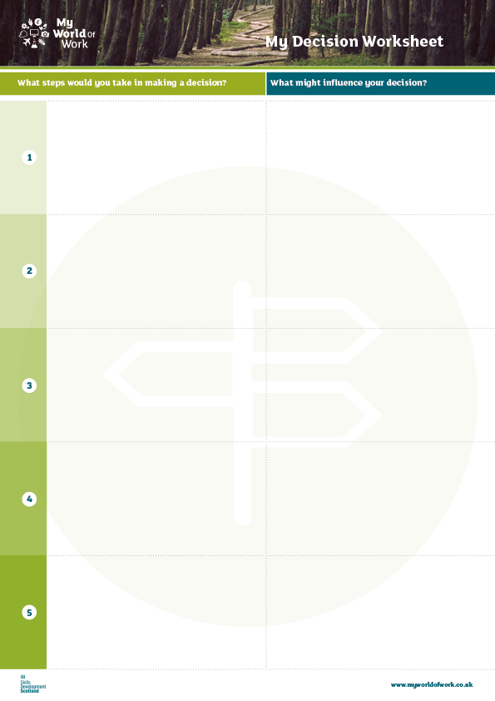
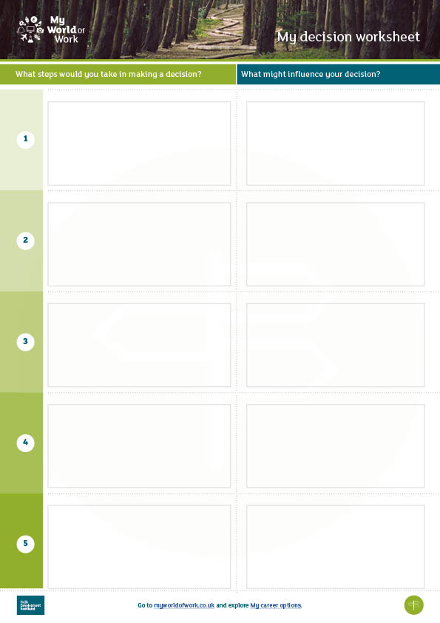
Routes and pathways
Decision making journey
Here is an example of what
steps you would take in making a decision about going to a concert.
Think about buying a mobile phone. What steps would you take to decide what phone to buy?
Think about which is my favourite
Past concerts
Location
Friends’ experiences
Do some research online
Cost
Dates
Reviews
Consult with parents or guardians
Permission
Transport
Ask friends
Advice from friends
Who can come
Notes:
Decision making journey
Explain to the class that they will now focus on some specific decisions. Using the example of buying a mobile phone, discuss with the class what steps they would take to decide what phone to buy (if stuck, prompt with ideas such as: speak to friends, try out a friend’s phone, try out in a phone shop, research online, etc.)
If time allows, provide each group with the Making decisions worksheet. Ask groups to fill this in, describing what steps they would take to decide what phone to buy. Use the completed example in the PowerPoint presentation to help illustrate the task.
They should consider what factors might influence their decision, e.g. friends, money, family, mobile network, visual appeal, compatibility, etc

Slide 6
Routes and pathways
Making career decisions
Think about the steps described in the decision making journey
How can these steps be used to help you make a career decision?
What factors would influence your choices?
Who can help you with making a decision?
What are all the possible options?
Notes:
Making career decisions
Now provide each person with a Making decisions worksheet and ask them to think about what steps they would take to make a career decision. This can be tailored to a specific career decision such as subject choices or leaving school and should be agreed with the class.
Ask them to think about what factors might influence their decision. They can discuss this in their groups.
Discuss each group’s answers with the class.

Slide 7
Routes and pathways
Review
What key things have you listed to help make your decision?
Research
your options
Speak
to other people
List
your preferences
Notes:
Review
Reinforce and draw comparisons with key points such as: speak to other people, carry out research, knowing your interests etc.
Emphasise that if they are willing to spend time making a decision about what phone to buy, they should spend the same and more thinking about their career.

Slide 8
Routes and pathways
Go to myworldofwork.co.uk and explore My career options
Notes:
Next steps
Pupils can research their career ideas further using My World of Work.
Pupils should go to myworldofwork.co.uk and select the green tab, My career options where they can explore career ideas further.
In a follow up lesson you could ask young people to consider how the decision making plan they’ve created would translate into an action plan for themselves.
Pupils can also speak to peers, older siblings, parents or carers to find out how they made decisions about their career. Pupils could prepare a case study or flow chart to show how the individual made a career decision and present their findings to the class

