Slide 1
Stereotypes
Equality and Diversity
BGE Third/Fourth
Notes:
Stereotypes activity
The purpose of this activity is to challenge ideas about the types of people that work in certain jobs.
Introduce the session:
In this activity you will consider examples of stereotypes that you are aware of and then match a selection of images of people to a set of job titles. This will help to identify any stereotypes that we might not be aware we have about the world of work.

Slide 2
Equality and Diversity
Learning intention
I will explore and challenge my views about jobs
Success criteria
I can discuss my views about jobs along with my peers and show respect for other people’s opinions
Notes:
Learning intention and success criteria
Go over the learning intention and success criteria with the class.
These can be adapted to suit the needs of your pupils and can be used as the basis for discussion.
To edit the information on the slide click on the slide and edit the text box.

Slide 3
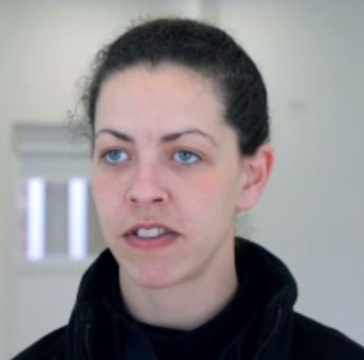
Quickly write down your observations about this person’s career path to share with the class.
Equality and Diversity
Notes:
Introduction to preconceptions
Use the example in the presentation to introduce the activity and ‘set the boundaries’ with the whole class, e.g. non offensive language, be sensitive to other people’s views, let people finish what they are saying before challenging their point
Ask questions such as ‘What kind of job does this person do?’, ‘Do you think they went to university?’
Once everyone has considered what they think she might do as a career move onto the next slide to reveal the truth about what she does.

Slide 4
Construction supervisor
Equality and Diversity
After school Tracey had a few different jobs, including office junior, hotel receptionist and gym instructor.
She was made redundant and found an opportunity to do an apprenticeship in joinery. She’s now training to be a construction manager.
‘If being indoors is not for you then I think construction would be ideal,’ says Tracey.
Tracey
Notes:
Introduction to preconceptions, continued
Using the information on the slide, go over what job the woman in the example does. Did anyone find this surprising? If so, why? Highlight and discuss any stereotypes that might have been presented.
Then, as a class or in pairs, ask pupils to come up with other examples of stereotypes they are aware of. Ask them to consider gender, race, religion, sexuality, hobbies, where people live etc

Slide 5
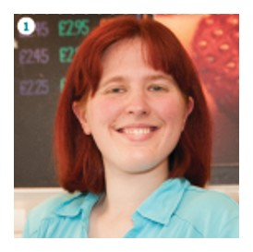
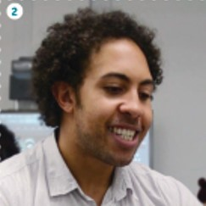
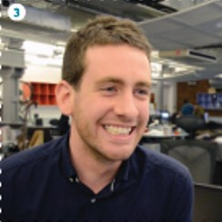
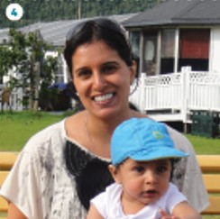
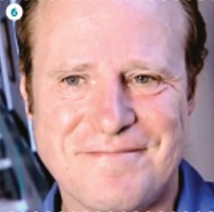
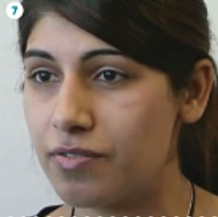
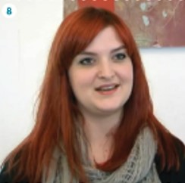
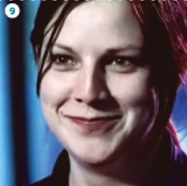
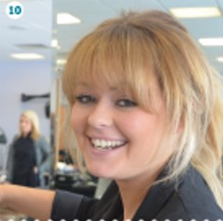
Job matching
Equality and Diversity
1
2
3
4
5
6
7
8
9
10
Image courtesy of iCould
Notes:
Analysing pictures and job matching
Now split the class into groups or pairs. Provide each group with the list of different jobs and pictures.
Ask the groups to review the job titles and pictures provided and then match the people to the jobs.
Once everyone has completed the task hand out the job profile fact sheet about what the person actually does or go over the answers as a class.

Slide 6
Discussion
Equality and Diversity
Did you match the correct pictures to the job titles?
Are you surprised by the results?
Notes:
Feedback and discussion
Ask the groups what they thought- were they right or wrong. Are they surprised?
Use this as an opportunity to challenge preconceptions e.g. gender stereotypes and have a class discussion.
Watch related video clips from My World of Work which challenge preconceptions surrounding disability, gender, race etc by copying the links below into your browser.
https://www.myworldofwork.co.uk/gas-service-technician-jacqueline
https://www.myworldofwork.co.uk/apprentice-web-designer-Jonathan
Or copy the links below into your browser and go through the advice in the article below.
https://www.myworldofwork.co.uk/my-career-options/career-expert-stereotypes-and-subject-choices

Slide 7
Stereotypes
Equality and Diversity
Go to myworldofwork.co.uk and explore My career options
BGE Third/Fourth
Notes:
Next steps
If there is time left and you have access to suitable ICT facilities, pupils can use My career options on My World of Work to find out more about the careers covered in this activity and more.
Ask pupils to log in to their computers, open an internet browser and go to myworldofwork.co.uk. They should then select the green tab, ‘My career options’ and use the ‘I have a career in mind’ tab to explore the job profiles. NB. Pupils do not need to be logged in to My World of Work to do this.
You may also want to invite guest speakers to talk to pupils at assemblies or in class (you can use Marketplace on My World of Work to organise this). Copy the link below into your browser to access Marketplace.
https://www.myworldofwork.co.uk/marketplace
Consider completing the Career: fact or fiction activity next to build on topics covered in this activity. Copy the link below into your browser to access the activity.
https://www.myworldofwork.co.uk/career-fact-or-fiction
You can also access more information by copying the links below into your browser.
Go to www.bewhatyouwant.org.uk to get more information on choosing the right career path. ‘Be what you want’ is a campaign to stop gender segregation in the world of work
Go to the Institute of Physics website to get more information and resources on improving gender balance in science subjects .

