Slide 1
My World of Work School Ambassador Subject Choices Toolkit

Slide 2
Getting ready to choose subjects
Choosing their subjects is an important time for lots of pupils in your school. Within this toolkit you’ll find ideas about how you could promote the subject choices help available from Skills Development Scotland and our website My World of Work.
What’s included:
Information on the resources your Careers Adviser in school will give to S2/3 pupils
Ideas on how you can help
Suggested social media posts to promote My World of Work
Information to add your school website
A profile picture for your school My World of Work Ambassador social media profile
.

Slide 3
Careers Adviser resources
These resources are good for you to know about how your Careers Adviser in school will introduce the new Future Me Subject Choices magazine to S2 & S3s in a classroom session, along with a presentation.
The Action Plan on the back page of the magazine has a step-by-step guide to help pupils prepare by using My World of Work.
Future Me Subject Choices magazine
front and back cover
Subject Choices
groupwork presentation

Slide 4
Posters and plasma advert
The below poster and plasma advert for TV screens are a reminder of the opportunity to have a one-to-one appointment with the Careers Adviser in school to discuss options with those choosing their subjects.
How you can help
Could you help put these up? Especially ahead of any school events or parents evenings about subject choices. Ask your Careers Adviser to download the plasma advert and to order the poster.
Poster
Plasma screen advert

Slide 5
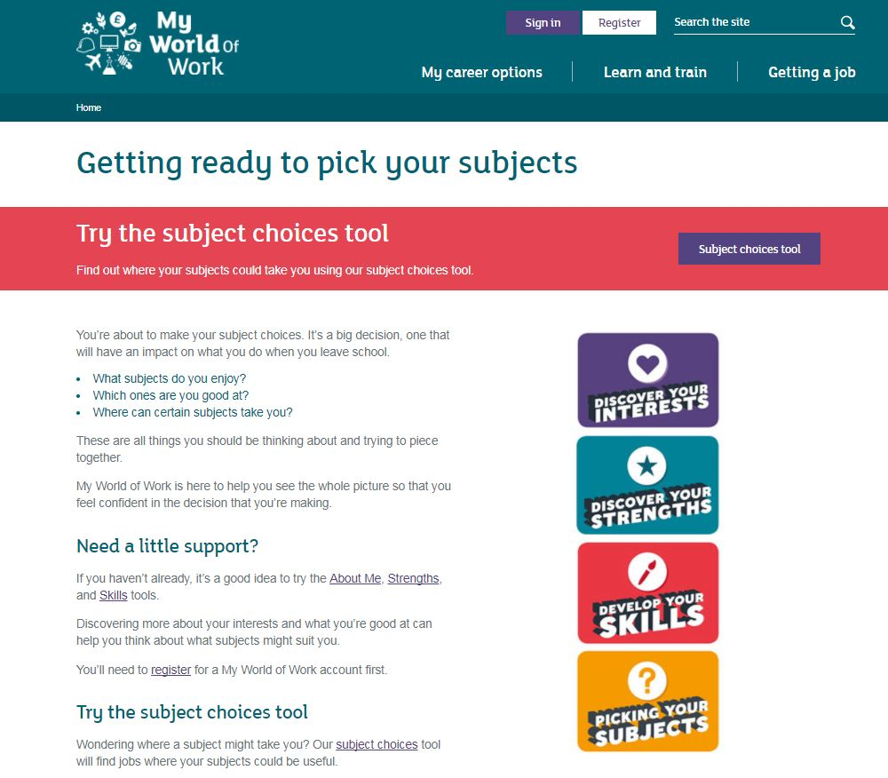
Getting prepared through My World of Work
How you can help
Encourage pupils who are choosing their subjects to complete the My World of Work Action Plan. How you could do this:
Remind pupils at school events to complete the Action Plan on My World of Work
Let parents/carers know about the Action Plan at events and where to find the information myworldofwork.co.uk/subjectchoices
Let parents/carers know there’s also help for them at https://www.myworldofwork.co.uk/my-career-options/choosing-school-subjects-advice-parents
Promote the Action Plan through the school’s social media channels and website. There are suggested posts, images and content in this toolkit.

Slide 6
Social media suggested posts
How you can help
Copy and paste the text below to create a post. You can choose from one of the GIFs or images on slides nine and 10 to accompany the posts.
About to make #subjectchoices? Get prepared with the help of My World of Work @mywowscotland. https://goo.gl/fPWcKz
Making #subjectchoices at school matter – pick subjects which develop your skills and bring out your strengths! https://goo.gl/fPWcKz
@mywowscotland can help you discover more about yourself so you can make better #subjectchoices! https://goo.gl/fPWcKz
When you’re making your #subjectchoices, ask yourself ‘The Big Five’ questions! https://goo.gl/fPWcKz

Slide 7
Social media suggested posts
How you can help
Copy and paste the text below to create a post. You can choose from one of the GIFs or images on slides nine and 10 to accompany the posts
Pick subjects you enjoy and use the #subjectchoices tool to explore careers your subjects could lead you to. https://goo.gl/fPWcKz
What brings out the best in you? Pick subjects you think will cater to these things! https://goo.gl/fPWcKz #subjectchoices
The #subjectchoices tool @mywowscotland lets you pick subjects, to see what careers would suit you best https://goo.gl/fPWcKz
With the #subjectchoices tool by @mywowscotland, save your favourites as part of your #careerplanning work https://goo.gl/fPWcKz

Slide 8
Social media suggested posts
How you can help
Copy and paste the text below to create a post. You can choose from one of the GIFs or images on slides nine and 10 to accompany the posts.
To get all the #subjectchoices support you need, sign up for an account with @mywowscotland. https://goo.gl/fPWcKz
If you’re making subject choices you can speak to your @skillsdevscot Careers Adviser. Parents can come too https://goo.gl/fPWcKz
Parents! Lots of help and information at @mywowscotland to prepare your child for #subjectchoices. https://goo.gl/ey4Xmo #parentsupport
Hey parents, @mywowscotland can help you help your child at #subjectchoices time! https://goo.gl/ey4Xmo
Parents, your school Careers Adviser is helping prepare your child for #subjectchoices. Find out how at: https://goo.gl/ey4Xmo

Slide 9
Social media GIFs
How you can help
1. Double click the ‘GIF image’ icon to the right of the image
2. Right click on the GIF in your browser and save to your desktop
3. Upload a relevant graphic to social media to accompany your post text

Slide 10
Social media images
Action
1. Double click the ‘PNG image’ icon to the right of the image
2. Go to ‘File’ and select ‘Copy’ to save the image it to your desktop
3. Upload a relevant graphic to social media to accompany your post text

Slide 11
School website
How you can help
Copy and paste the text below to relevant pages of your school website, e.g. The news section or the blog. If the hyperlink doesn’t copy onto your site, right click the highlighted text and select ‘edit hyperlink’ to see the page it should link to. Check with your teachers and Careers Adviser first.
Subject choices - helping you choose
Your subject choices at school can have an impact on what you can study at college or university and what jobs you can go for in the future. Help is at hand from Skills Development Scotland.
Your Careers Adviser in school can help you think about the right subject choices for you. You can meet with them to discuss your choices and bring a teacher or parent/carer if you like. Ask them about the Future Me - Subject Choices magazine as it is full of hints and tips.
Your careers website, My World of Work also has lots of help and advice. Complete the Action Plan to help you get prepared:
Register on My World of Work
Complete the About Me quiz
Try the Strengths tool
Try the Skills tool
Use the Subject Choice tool.
Get started at myworldofwork.co.uk/subjectchoices

Slide 12
My World of Work School Ambassador profile picture
How you can help
If your school has a My World of Work Ambassador social channel, use this image as your profile picture.
1.Right click and ‘Save as Picture’ to your desktop
2. Upload to the relevant social media page

Slide 13
Extra help
Remember to speak to your teacher who is leading the Ambassador programme in your school and your Careers Adviser about the ideas and contents of this toolkit. Always check before posting anything on social media or the school website.
Find out if your school is holding any relevant events you could help with to promote the help available
Make sure to follow My World of Work on Twitter from your school profile - @mywowscotland
Look out for other content you can share, retweet and post on social media from My World of Work over the next few months
If you have any questions about this toolkit, please get in touch with marketing@sds.co.uk

