Slide 1
Animal Me 2

Slide 2
Learning intention
I will learn about my personality and strengths and how these relate to different jobs
Success criteria
I can understand the meaning of preferences
I can identify my strengths
I can participate in a team better through an understanding of my own strengths and those of other people
I can research different jobs on My World of Work

Slide 3
What are preferences?
For example
Fold your arms one way and then the other
Write your name with one hand and then the other
Although we can fold our arms many ways and write with both hands we tend to just use one – our preference.

Slide 4
Eddy
I think out loud
I prefer variety and action
I like to act quickly
I’m a good talker
I like to give my opinion
Ian
I prefer quiet
I like to be careful
I’m a good listener
I keep my thoughts to myself
I think before I speak
Notes:
Go through the preferences for Eddy and Ian. Use these examples to bring them to life. Eddy- Donkey, Katy Perry. Ian- Shrek, Andy Murray.

Slide 5
Sharon
I look for the facts
I look for details
I focus on what works now
I prefer using what I’ve learned
I’m more practical and sensible
Naz
I look for the possibilities
I like to work out what it means
I focus on how to make it different
I prefer learning new skills
I’m more of a dreamer and imaginative
Notes:
Go through the preferences for Sharon and Naz. Use these examples to bring them to life. Sharon- James Bond, Lady Gaga. Naz- JK Rowling, Dr Who.

Slide 6
Frank
I tend to follow my heart
I ask, ‘How will it affect people?’
I like pleasing people
Giving praise is more important
I tend to be careful saying things that could upset someone
Tom
I tend to follow my head
I ask, ‘Is it the right decision?’
I like rules and principles
Telling it ‘how it is’ more important
I tend to give and take criticism quite easily
Notes:
Go through the preferences for Frank and Tom. Use these examples to bring them to life. Frank- Martin O’Neill, Cheryl Cole. Tom- Simon Cowell, Sir Alex Ferguson.

Slide 7
Jane
I like to plan and organise things
I like to make decisions
I prefer finishing tasks
I quite like using lists
I like things tidy
Paula
I like to see how things turn out
I like to keep my options open
I prefer starting tasks
I’d rather not use lists
I don’t mind things untidy
Notes:
Go through the preferences for Jane and Paula. Use these examples to bring them to life. Jane- Fred and Welma, Marge Simpson. Paula- Shaggy and Scooby, Homer Simpson.

Slide 8

Take the Animal me quiz
Find out which animal you are most like
Understand your personality and what you are good and also what jobs might suit you.
Discuss the results as a class – are they what you expected?

Slide 9




Clownfish - ENFP
Seal - INFP
Generally cheerful with an infectious enthusiasm
Curious about everything and always seem to be asking ‘why?’
Co-operative and very sociable but also need time alone
Care about others and likes to be liked
Fun | Imaginative | Spontaneous
Quiet, gentle and good peacemaker
Adaptable, doesn’t make a fuss
Has original ideas and often idealistic
Laidback but likely to be messy and unstructured
Curious | Adaptable | Idealistic
Sea animals
Dolphin - ENFJ
Seahorse - INFJ
Loves doing things for others
If not confident can worry excessively, feel guilty and be sensitive to criticism
Popular and good communicators
Trustworthy, can inspire and lead others
Organiser | Caring | Helper
Gentle, caring and highly intuitive
Great instinct and usually know or sense when something is right
Likes peace and harmony. Dislikes conflict and can become agitated and angry
Creative and can be messy
Organised | Creative | Caring

Slide 10



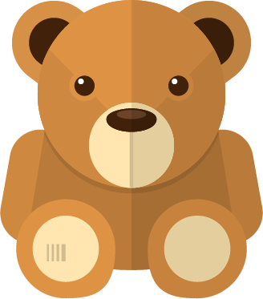
Koala - ISFJ
Polar bear - ISTJ
Co-operative and caring
Can work at a steady pace until the job is done
Friendly, but usually won’t express their views until asked
Loyal to family, employer and friends.
Independent | Kind | Dependable
Quiet, gentle and good peacemaker
Has original ideas and often idealistic
Believe in helping and are very loyal
Laidback but likely to be messy and unstructured
Curious | Adaptable | Idealistic
Bears
Black bear - ESTJ
Teddy bear - ESFJ
Outspoken, assertive and self confident
Good at devising plans and achieving goals
Can be bold and direct
More concerned with getting the job done than how people feel
Decisive | Organiser | Logical
Warm, energetic and loves people
Responsible and dependable
Practical and realistic
Have definite ideas about how things should be done and will tell people
Determined | Enthusiastic | Helpful

Slide 11




Eagle - ENTJ
Barn owl - INTJ
Innovative, creative and good planners
Like imaginative projects with their own ideas
Can be direct and challenging
Often self-confident with good communication skills
Leader | Decisive | Analytical
Organised
Private and independent
A calm, but creative thinker
Natural and leader
Often have strong views and believe they are right
Original | Driven | Achiever
Birds
Tawny Owl - INTP
Falcon - ENTP
Curious about what makes things work
Prefers to find solutions than implement them
Shy with new people, but fun and confident in their small circle of close friends
Enjoy working on their own with little routine
Independent | Logical | Curious
Ideas people who see possibilities everywhere
Often finish less things than they start
Good at problem solving
Creative and curious
Quick thinker who likes logic
Ingenious | Outspoken | Strategist

Slide 12

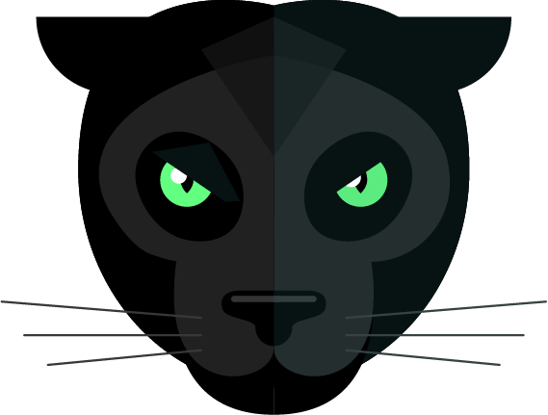

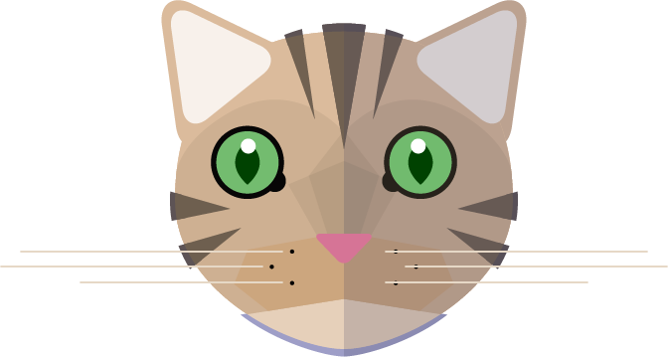
Lion - ESFP
Panther - ESTP
Innovative, creative and good planners
Like imaginative projects with their own ideas
Likes to take charge but not do everything
Often self-confident with good communication skills
Leader | Decisive | Analytical
Creative and enjoy developing ideas
Observant and assertive
Gets bored quickly, dislikes theory, like to get on with it, but doesn’t always finish it
Loves to have fun and fun to be around
Spontaneous | Explorer | Achiever
Cats
Tiger - ISTP
Cat - ISFP
Confident and independent
Makes decisions based on fact
Like to be up and about, doing things
Have firm beliefs but don’t always follow the rules
Logical | Flexible | Tolerant
Quite private – can be hard to get to know
Fun to be with
A doer, uncomfortable with too much thinking or theory
No desire to lead or control or be so
Strong desire to please
Observant | Considerate | Loyal

Slide 13
What does this mean?
Everyone is different – teams need all personality types
By understanding ourselves better we can learn to get on with classmates better
By understanding each other, we can work better in teams

Slide 14
Job ideas
Here is how to investigate job ideas on line:-
My World of Work https://www.myworldofwork.co.uk/my-career-options
Using the worksheet, explore your favourite job idea

Slide 15
Go to myworldofwork.co.uk/primary and use your Profile to record what skills you have used taking part in this lesson

