Slide 1
The world of work
Know your stuff for interviews
Senior Phase
Notes:
Know your stuff for interviews activity
The purpose of this activity is to emphasise the importance of carrying out research on an employer before attending an interview.
Introduce the session:
In this activity you will learn how to prepare for an interview and carry out research on a local employer to find out what information would be of use in an interview.

Slide 2
The world of work – Know your stuff for interviews
Learning intention
I will learn about interviews
Success criteria
I can complete appropriate research in preparation for an interview
I can state what preparation is needed before attending an interview
Notes:
Learning intention and success criteria
Go over the learning intention and success criteria with the class.
These can be adapted to suit the needs of your pupils and can be used as the basis for discussion.
To edit the information on the slide click on the slide and edit the text box.

Slide 3
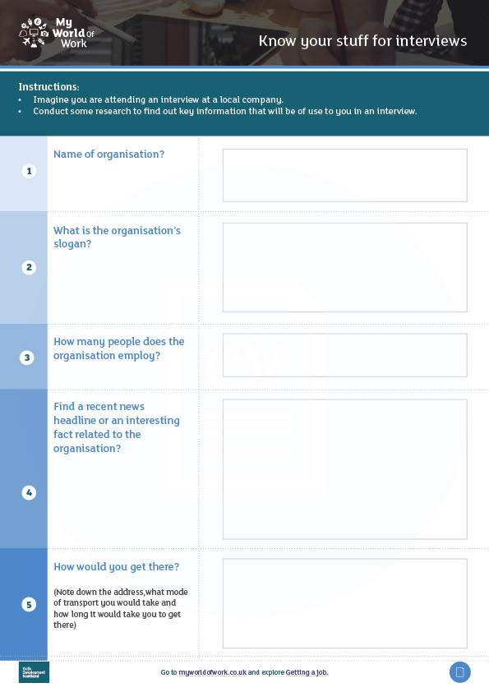
The world of work – Know your stuff for interviews
Imagine you are attending an interview at a local company. Do some research to find out key information that will be of use to you in an interview.
Trent taxis
We drive your dreams
25
Trent Taxis charity funfair
28 Wilson Road, TDD 111 1 hour journey by bus, number 21
Notes:
Introduction
Discuss why it is important to know background information about the company you are applying to and to plan ahead for attending the interview.
Working in pairs or cooperative learning groups ask the class to imagine they are attending an interview at a local company and are going to conduct some research to find key information that will be of use in the interview.
Ask pupils to come up with names of local companies that they know of. You should also have some local employer examples prepared. Decide if you want the class to research the same employer or individual ones and agree the company that each group will research.

Slide 4
The world of work – Know your stuff for interviews
Use the worksheet or your notebook to record:
Name of organisation
What is the organisation’s slogan?
How many people does the organisation employ?
Find a recent news headline or interesting fact related to the organisation
What would you wear to an interview with this organisation?
How would you get there? (address, mode of transport and how long it would take you to get there?)
Notes:
Research a local company for a fictional interview
Issue the worksheet for pupils to complete and go over the questions (continued on the next slide).
Pupils can also add their own questions and supplementary information.
To reduce printing you could ask pupils to record their answers in a notebook or blank sheet of paper.

Slide 5
The world of work – Know your stuff for interviews
Use the worksheet or your notebook to record:
What does the company do?
Who is their target audience?
What is their best selling product?
Who is the owner of the company?
Add any other information you think might be useful
Notes:
Research a company for a fictional interview continued
Research questions continued.
Pupils can also add their own questions and supplementary information.
Once pupils have completed their research ask each group to present back some of the key information they found out.

Slide 6
The world of work – Know your stuff for interviews
Now log on to www.myworldofwork.co.uk and start exploring the Getting a job section.
Notes:
Next steps
Pupils should visit My World of Work and complete the Interview tool, a video based mock interview quiz. This can be done individually or you can also go through the tool in pairs or as a class if ICT resources are limited.
To access the Interview tool pupils should go to myworldofowork.co.uk and select the blue tab, ‘Getting a job’ and scroll down to the Interview section. In this section they should select ‘Try the interview tool’ from the navigation bar. NB. Pupils do not need to be logged in to My World of Work to access this tool.
https://www.myworldofwork.co.uk/myinterviewtool/start
After completing these activities, you may wish to progress onto the Mock Interview activity.

