Slide 1
Routes to employment
Notes:
Routes to employment activity
The purpose of this activity is to explore the different routes available to get to one specific area of employment.
Introduce the session:
In this activity you will learn about the 10 key routes to employment. You will research the different options available for someone looking to do a particular job. You will then explore your own career pathway and the available options.

Slide 2
Learning intention
I will learn about the various routes into employment
Success criteria
I can identify different routes into employment
I can use My World of Work to research options available to me
Notes:
Learning intention and success criteria
Go over the learning intention and success criteria with the class.
These can be adapted to suit the needs of your pupils and can be used as the basis for discussion.
To edit the information on the slide click on the slide and edit the text box.

Slide 3
Routes to employment
Key pathways:
College
Work experience
University
Start your own business
Volunteering
Employment
Modern Apprenticeship
Foundation Apprenticeship
Graduate Level Apprenticeship
Training
Notes:
Introducing routes to employment
Initiate a class discussion about different routes to employment.
Discuss what is involved in these 10 different routes; college, Modern Apprenticeships, Foundation Apprenticeships, Graduate Level Apprenticeships, starting your own business, work experience, employment, university, volunteering and training, e.g. Certificate of Work readiness.
Refer to the links below to get more information about each of these options if required
https://www.myworldofwork.co.uk/learn-and-train/learning-options
https://www.myworldofwork.co.uk/my-career-options/employment-options
https://www.myworldofwork.co.uk/getting-job/apprenticeships

Slide 4
Lisa’s career journey
Lisa’s goal is to work with animals
Route 1
Work experience / Volunteer
Modern Apprenticeship
Employment
Lisa volunteers during the weekend and on school breaks at a riding centre.
She decides to leave school to start a Modern Apprenticeship in Equine training at the riding centre. Lisa is an ideal candidate as she has previous experience.
As part of her apprenticeship Lisa completes her academic training at Cartney Horse Sense in North Lanarkshire.
Lisa has worked hard during her apprenticeship and her employer keeps her on.
Notes:
Introducing routes to employment , continued
Using the example of Lisa, discuss what Lisa’s possible progression routes are to achieve her goal of working with animals.
Discuss and consider the pros and cons of each route (slides 5 – 8). This gives the opportunity to explore challenges, e.g. moving away from home, a low wage start, lack of jobs after college/university/etc.

Slide 5
Lisa’s career journey
Lisa’s goal is to work with animals
Route 2
Work experience / Volunteer
School
University
Employment
Lisa gains work experience at the weekends and her school holidays at a local farm.
She stays on at school and gets 5 Highers by the end of S5, including Chemistry, Biology and Maths (at Grade A).
She studies Veterinary medicine and surgery at Glasgow University,
After 5 years at university she graduates and gets a job at a veterinary hospital.

Slide 6
Lisa’s career journey
Lisa’s goal is to work with animals
Route 3
School
College
Starts a business
Lisa stays on at school and gets 2 Highers (at Grade C), one of which is biology.
Lisa takes a one-year HNC course in Agriculture at Scotland’s Rural University College where she learns about running a farm.
She decides to stay on at the college and joins the HND Agriculture course.
Lisa achieves her HND and with this goes on to start her own farming enterprise.

Slide 7
Lisa’s career journey
Lisa’s goal is to work with animals
Route 4
School
College
University
Lisa achieves 5 National 5 qualifications at school, including English, maths and biology.
While at school she completes 2 weeks work experience at her local veterinary practice.
Lisa achieves her Diploma in Veterinary nursing from college.
Lisa realises she can continue on to University to study a BSc (Hons) in Veterinary nursing.

Slide 8
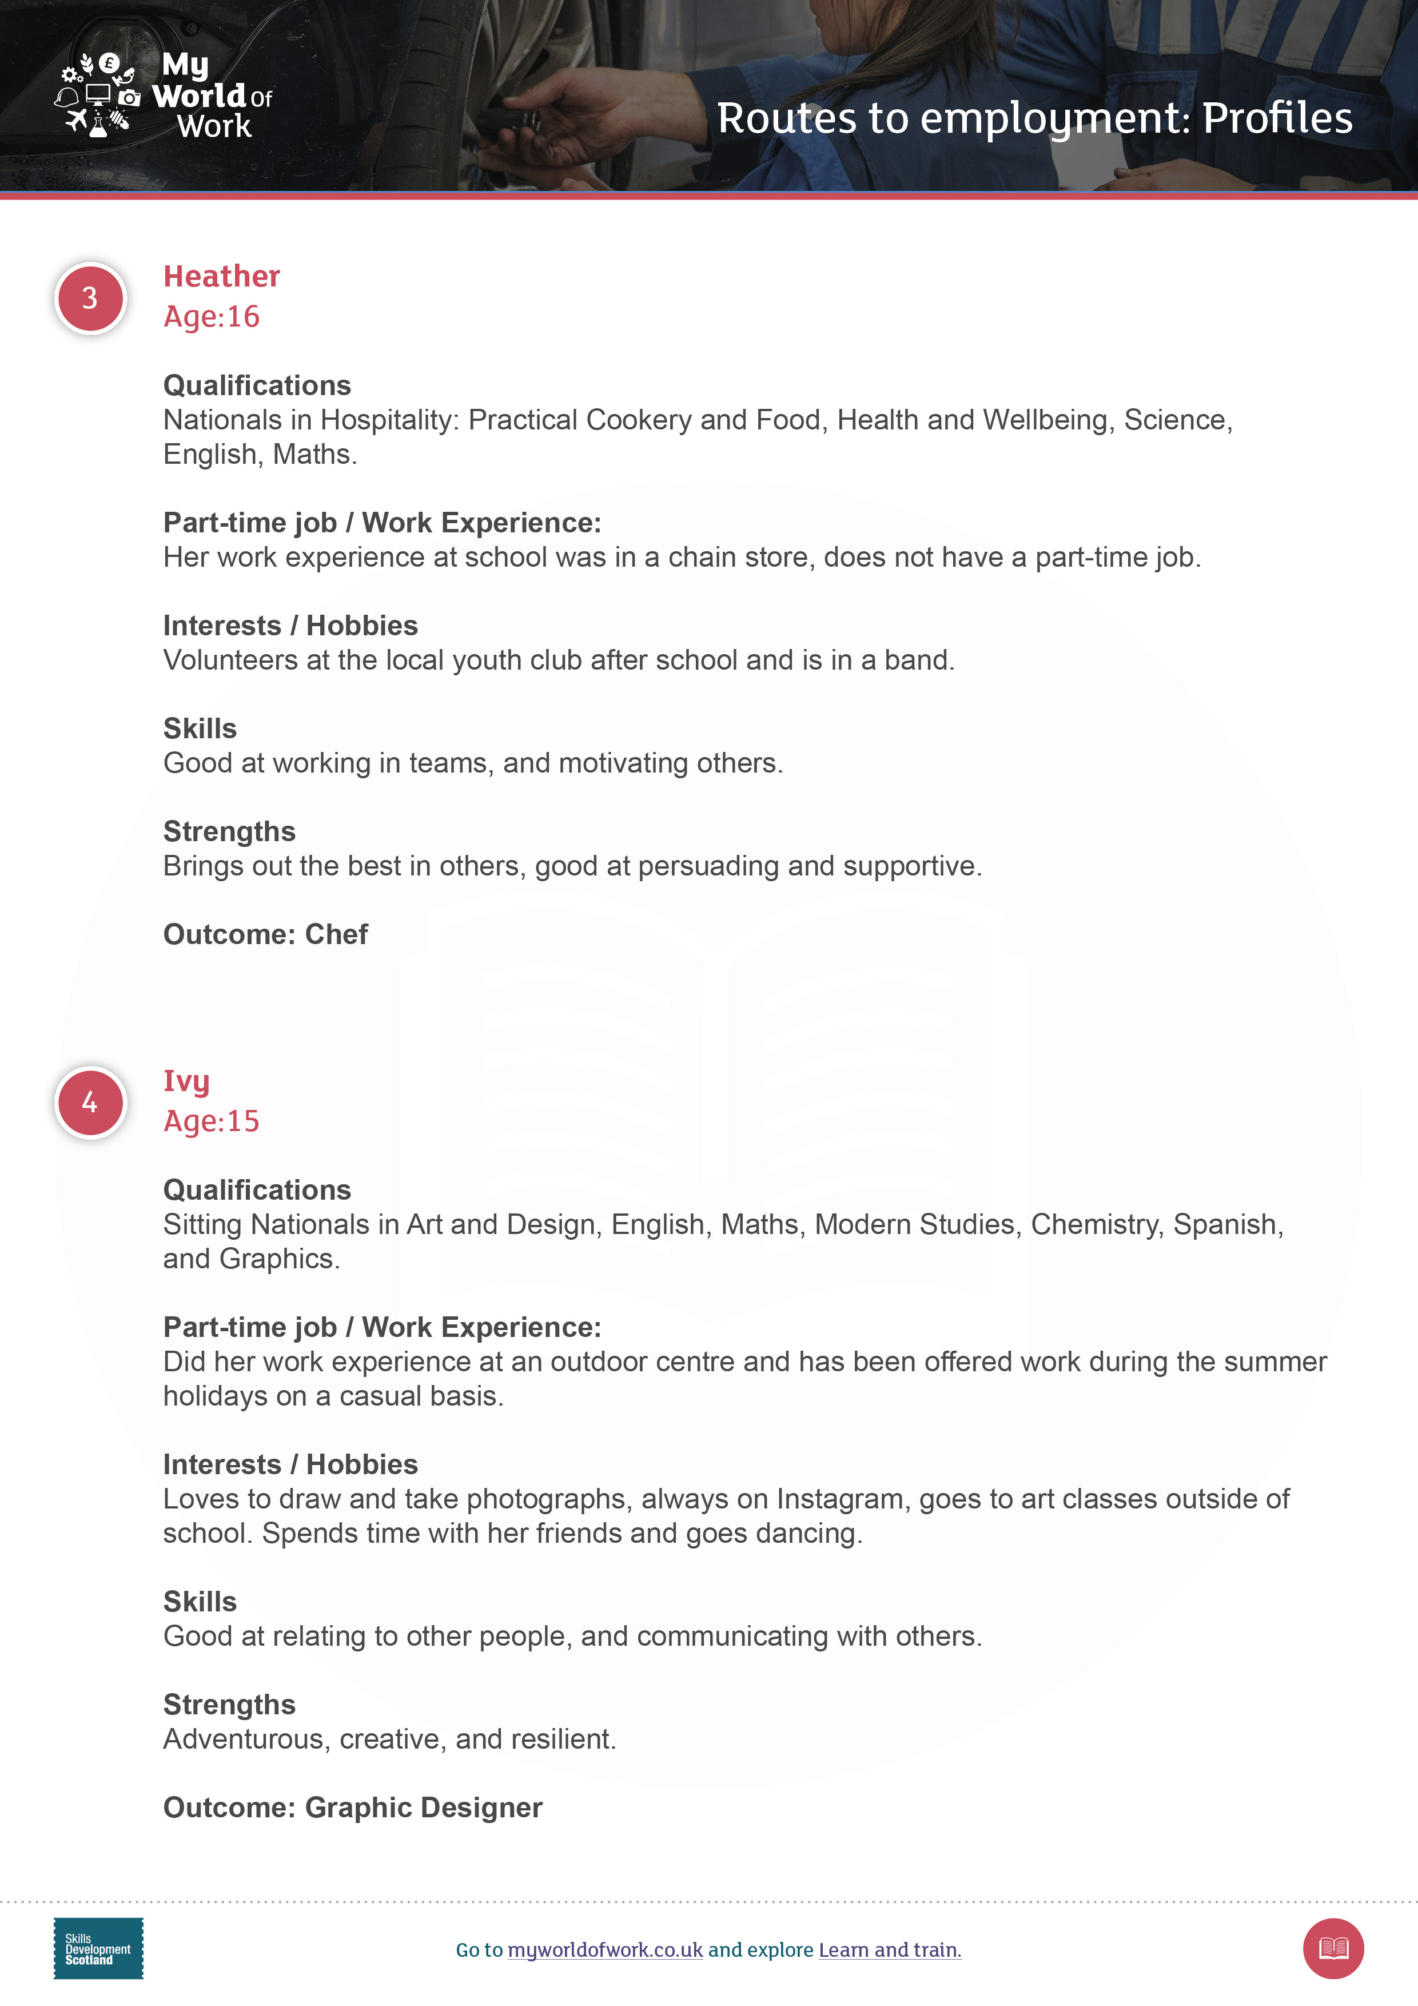
Case studies
Research possible options and routes for the person featured in your profile. Consider using:
My World of Work
My career options
Learn and train
Apprenticeships.scot
University or college websites
Notes:
Case studies
Split the class into seven groups, or more if required.
Issue profiles: Simon, Kevin, Heather, Ivy, Keith, Ahmed and Amanda, giving one to each group. Also issue a blank ‘Career journey’ worksheet to each group for completion.
Explain to the class that each group must identify possible routes to help the individual in their profile achieve their desired outcome. Groups should aim to record more than one possible route to achieve the outcome, just like the example of Lisa who had four different options.
Ask pupils to go to My World of Work to research accurate information for their case study using the ‘I have a career in mind tab’ within My career options, as well as the Learn and train section. They can also use Apprenticeships.scot and college or university websites too.
https://www.myworldofwork.co.uk/my-career-options#I_have_a_career_in_mind
https://www.myworldofwork.co.uk/learn-and-train
https://www.apprenticeships.scot/

Slide 9
Career journey worksheet
Complete the Career journey worksheet with the possible routes you have identified for your case study, like the example below
Record at least two routes to achieve the preferred career in your example
Foundation Apprenticeship in Engineering during S5/ S6
Leave school at the end of S6 and go to college to study HNC Engineering
After completing an HNC go to University to get a degree in Mechanical engineering
Get a job as a Mechanical engineer
Notes:
Case studies continued
Ask pupils to use the Career journey worksheet to record the possible routes they have identified for their case study.

Slide 10
Present your case study
As a group choose the preferred option for the individual in your profile
Present the route you have chosen for your case study
Discuss why you have chosen this route, i.e. pros and cons
Notes:
Routes and pathways case studies continued
Groups should choose a preferred route for the young person in their case study and present their findings to the class, justifying their decisions for their preferred route
Use the factsheet to discuss alternative ideas that they may not have identified in their groups.

Slide 11
Create your own career journey
Start to build your own career profile by listing your qualifications, work experience, interests, skills and strengths
Chose a job or area of work that interests you
Now go online to explore different career routes for the job you have chosen
Notes:
Create your own career journey
Issue everyone with their own Career journey worksheet. On the back of the worksheet, ask pupils to list some information about their own work experience, qualifications, interests, strengths and skills, just like the profiles they have been working with earlier.
Pupils should choose a job outcome that they are considering.
Pupils should now explore different routes towards this job outcome using online resources such as My World of Work and record their options on the Career journey worksheet.

Slide 12
Notes:
Next steps
Pupils can continue to research learning and training options further using the Learn and train section in My World of Work.
Pupils can go to Apprenticeships.scot to find out all they need to know about apprenticeships.

